Slide 1
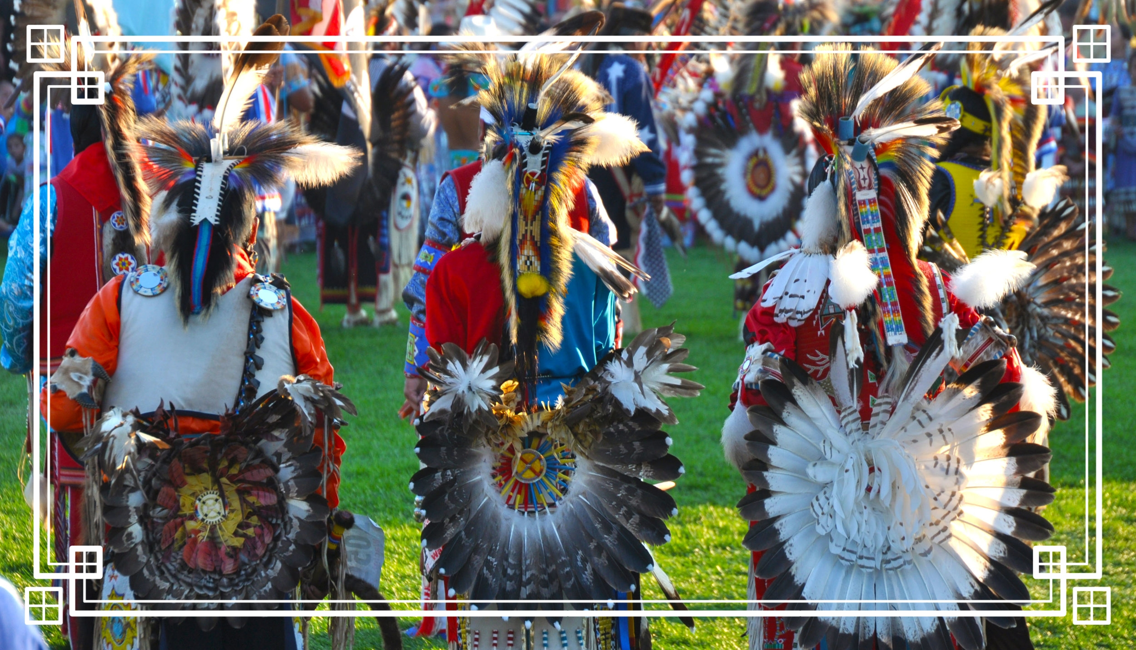
Bii Gii Wiin
MCAD Collaboration
Adria Domine, Audrey De Ridder, Rebecca Albert, Zoe Blyss
Notes:
https://pixabay.com/en/macbook-apple-imac-computer-screen-606763/
Becca

Slide 2
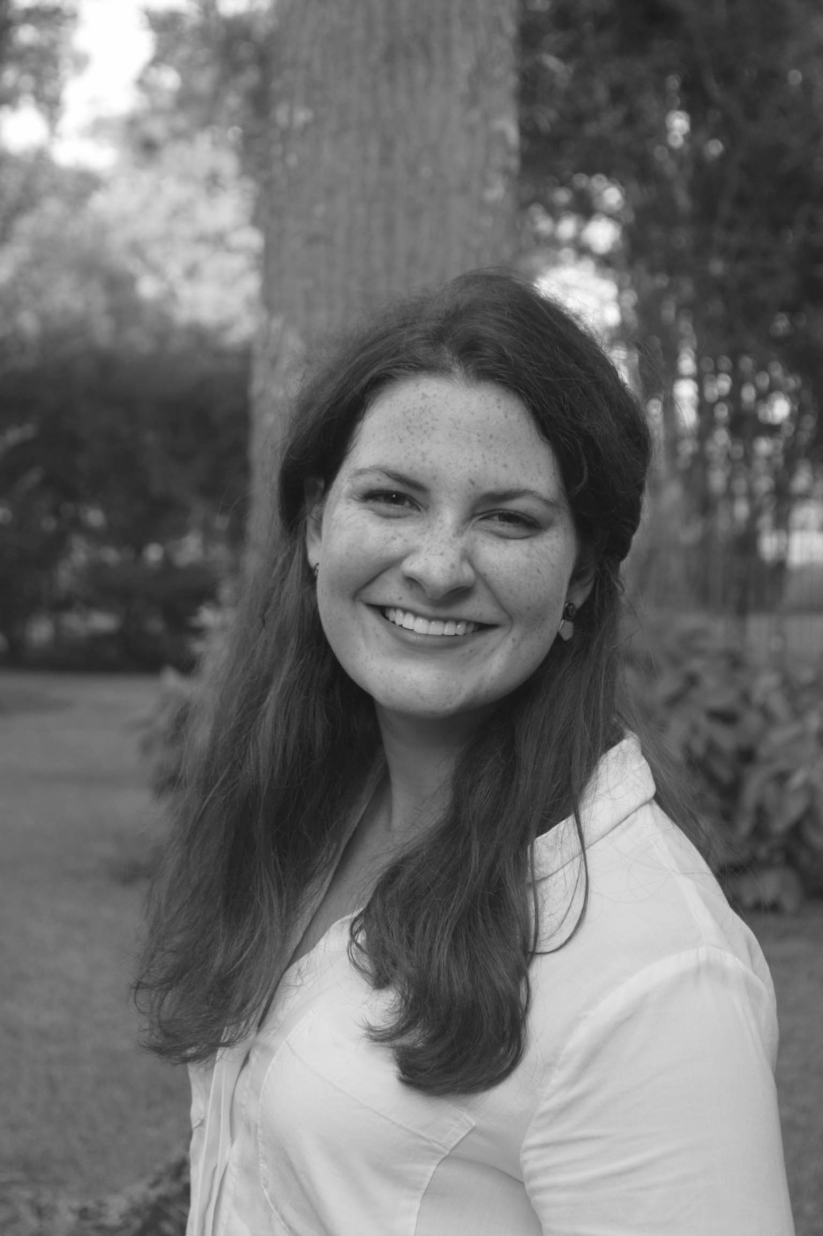

The Team
Adria Domine
Entrepreneurial Studies, 2019
Research & Development
Audrey De Ridder
Entrepreneurial Studies, 2019
Research & Development
Rebecca Albert
Entrepreneurial Studies, 2019
Project Manager
Zoe Blyss
Entrepreneurial Studies, 2019
Scrum Master, Outreach
Notes:
All

Slide 3
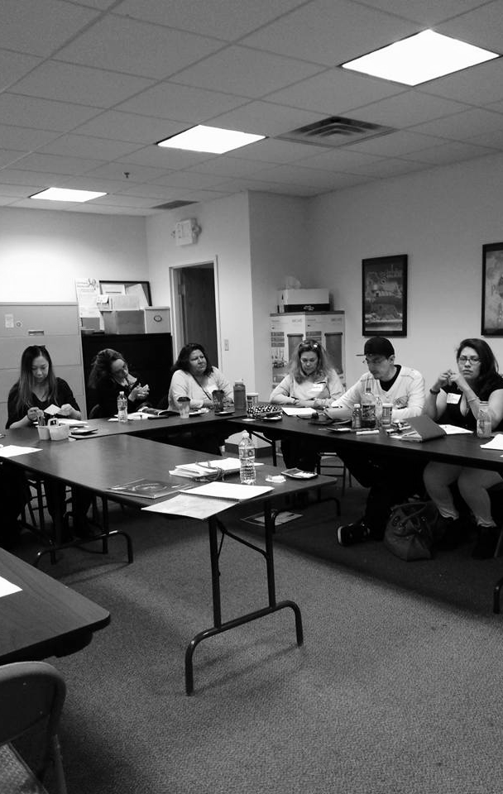
The Client
Bii Gii Wiin’s mission is to provide resources to American Indian communities throughout Minnesota on topics including:
Homeownership
Entrepreneurship
Financial Literacy
Notes:
BECCA
Restate the business problem presented by the client and the approach you agreed to pursue in your Statement of Work. Act as a spring board for the american indian community into the financial sphere regardless of previous knowledge or financial staus.

Slide 4
The Agenda

Slide 5
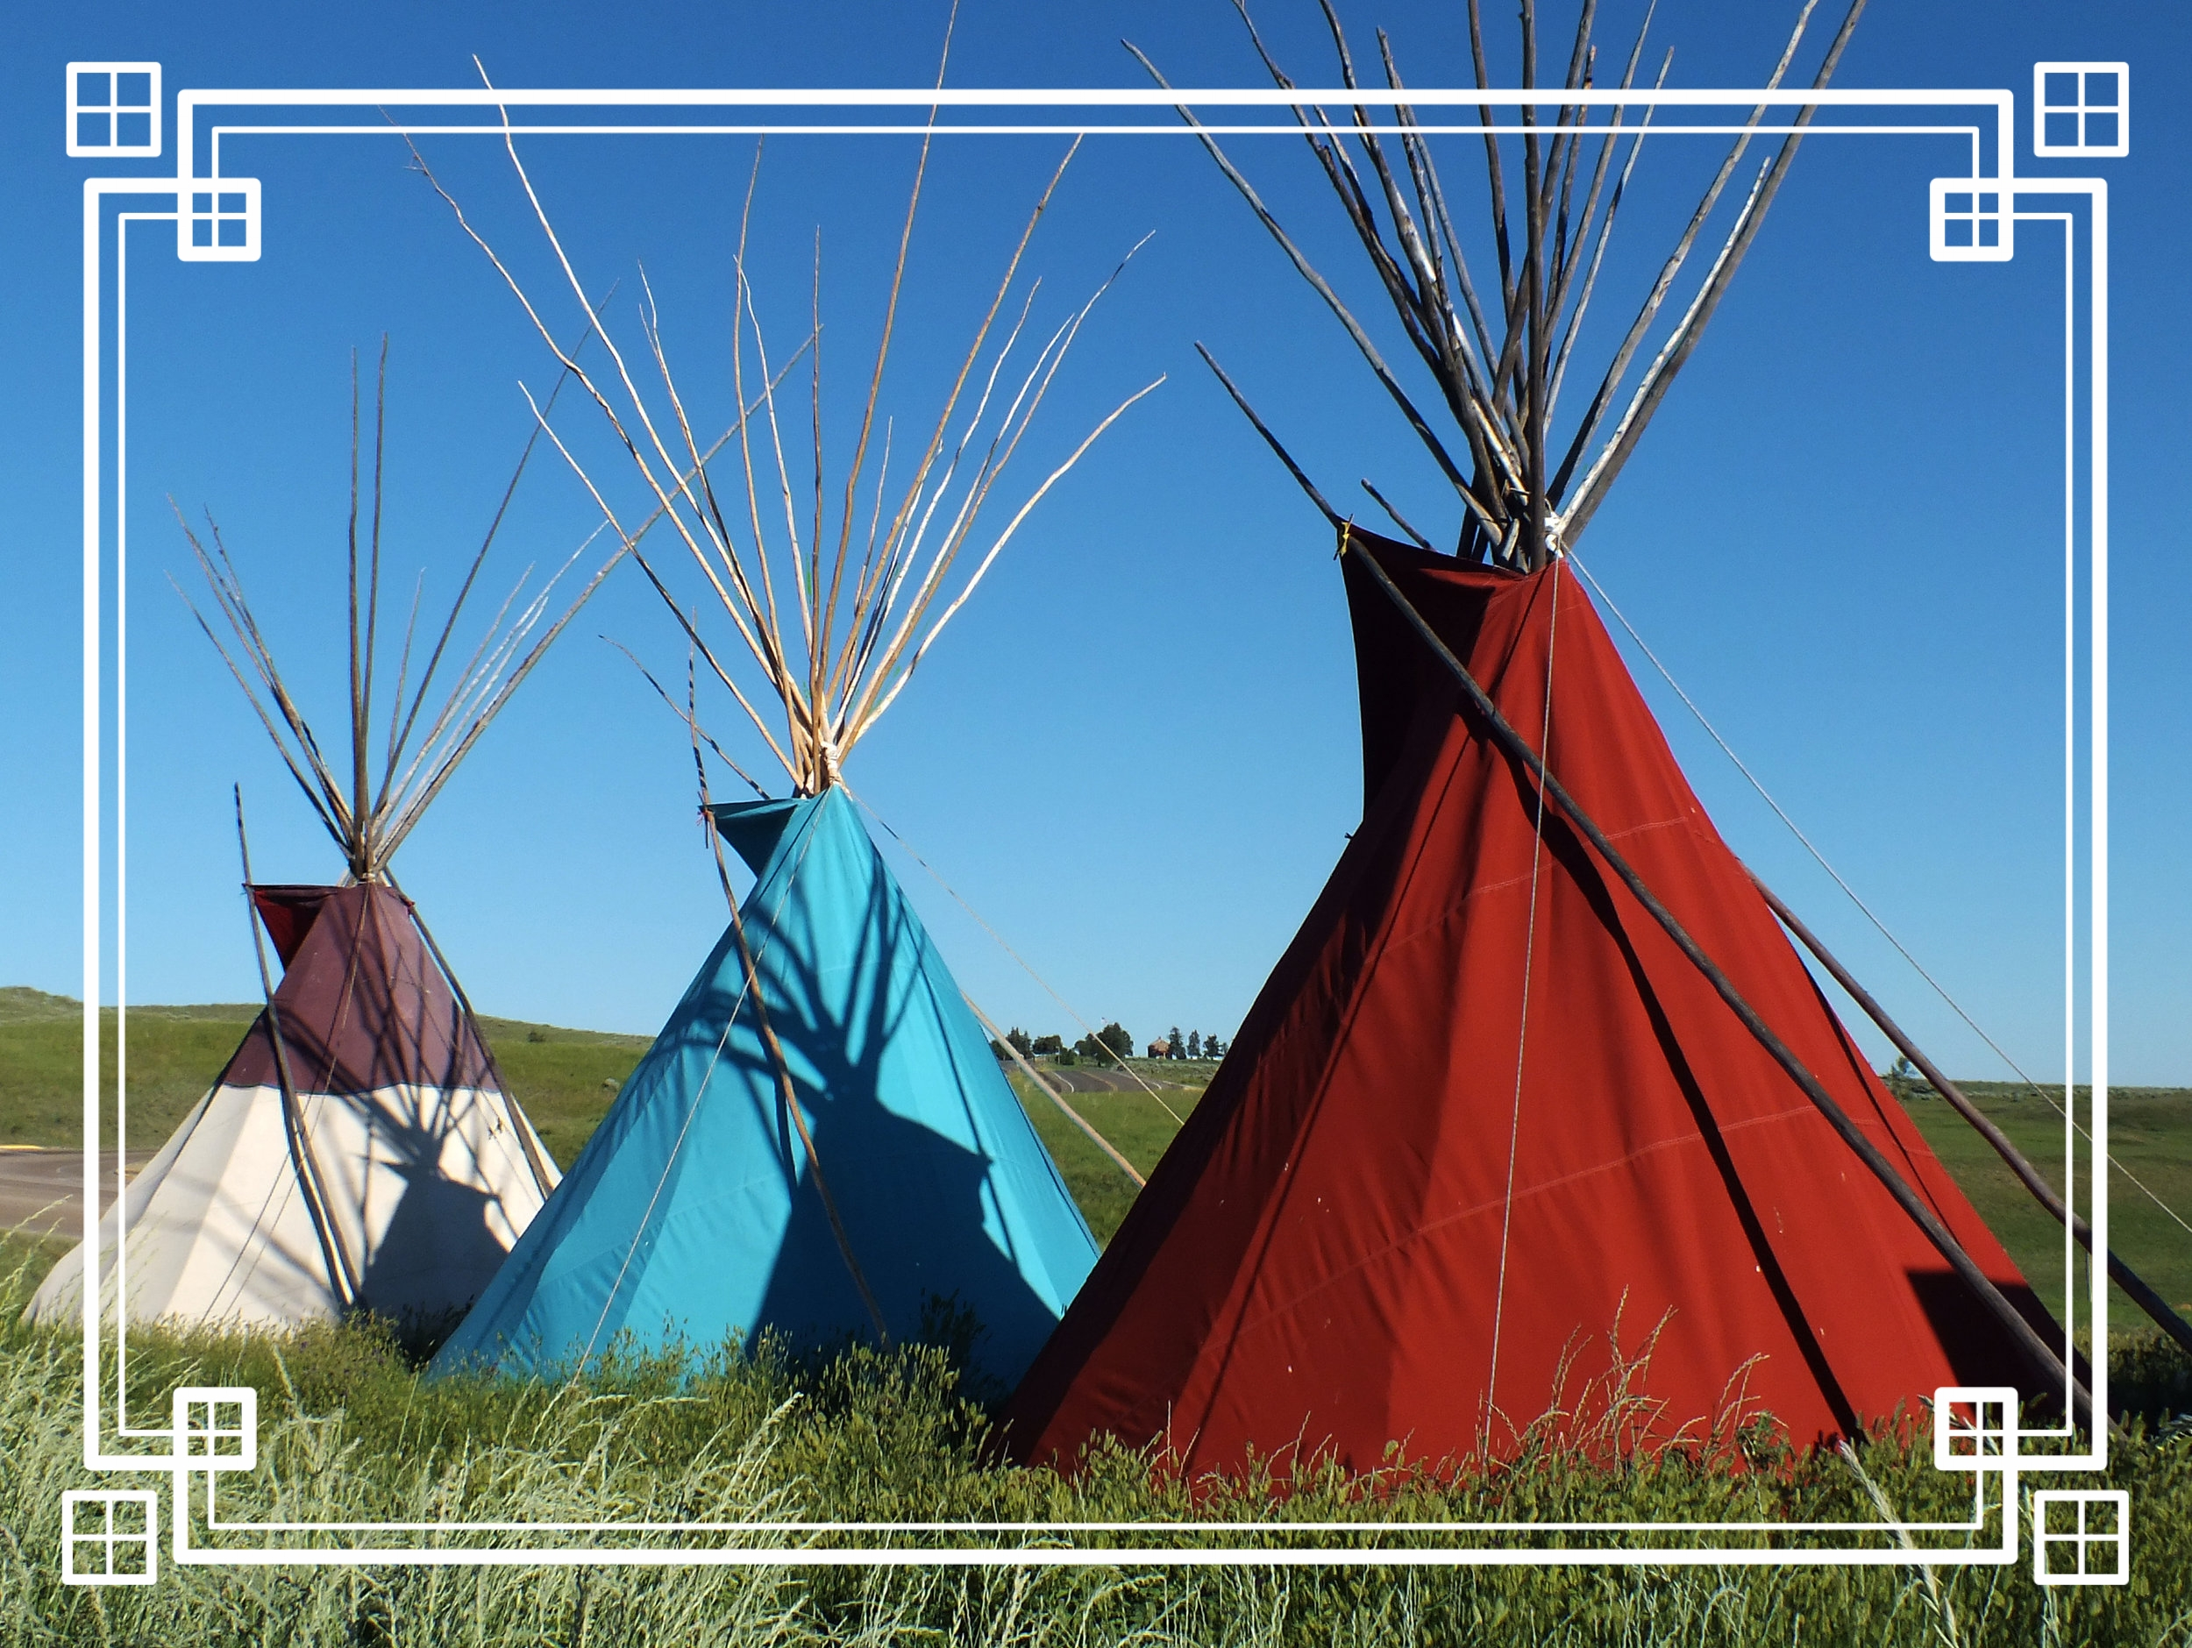
Project Overview
Mission, Process, 4Ps
The Research
Methodology, Findings
The Recommendations
Social Media, Information Guides, Customer Experience, Data Collection
Wrap Up
Notes:
AUDREY
https://pixabay.com/en/chairs-conference-room-long-table-1840377

Slide 6
Project Overview

Slide 7
Our Mission
To evaluate how to increase awareness of the organization within the local community, identify the typical customer journey, and strategize how to retain customers within the organization.
Notes:
BECCA
Restate the business problem presented by the client and the approach you agreed to pursue in your Statement of Work
BGW was born with the mission of supporting a community that hasn’t

Slide 8
Our Process
Background research, first-hand research
Analysis of research gathered and received
Final deliverables and recommendations
Industry research
Focus groups
Identifying trends
Pin-point gaps
Recommendations
Implementation
Notes:
ADRIA
We started this project out with various types of research about the industry and organization before conducting focus groups to gather first-hand research. As we wrapped up this research we started the analysis phase of the project - trying to identify trends and pin-point gaps within and surrounding the organization. Following, this research and analysis lead us to the development of our final deliverables and recommendations before strategizing how the organization can easily implement them.

Slide 9
The 4Ps
Purpose
“Provide training and access to capital... among American Indian men and women”
Helping build intergenerational wealth through home buying / business
Progress
Variety of course offerings
New leadership
MCAD collaboration
Potential
Promoting financial literacy within the American Indian community
Organization growth
Business consulting services
Partners
Native American Community Development Institute
MN Indian Women’s Resource Center
Women Venture
Neighborhood Development
Department of Employment and Economic Development
Notes:
ZOE: PURPOSE
ADRIA: PROGRESS
AUDREY: POTENTIAL
BECCA: PARTNERS
Their 4 ps (purpose, progress, potential, partners)

Slide 10
The Research

Slide 11
Research Methodology
External
Internal
First Person
Industry Research and
Competitor Analysis
Internal Business Audit and
Social Media Overview
First Person Focus Groups and Phone Interviews
Notes:
BECCA

Slide 12
Research Findings
Other organizations out
there provide:
- Access to tools & information online
- Database of company data
- Resources for larger loans
External
Notes:
AUDREY
Cultural Research
Competitors
Partners/Other Resources

Slide 13
Research Findings
Internally you have:
- Established relationships with your current and previous clients
- Underdeveloped social media presence
- Good rapport in the community
- Minimal bandwidth
Internal
Notes:
ADRIA

Slide 14
Research Findings
What we heard from your clients:
- Very positive overall reviews
- Referral was typically from a personal connection or another organization
- Further explanation on course
offerings and next steps
- Opportunity for stronger brand
identity and messaging
First Person
Notes:
ZOE
Focus on opportunity for growth

Slide 15
The Recommendations

Slide 16
List of Recommendations
Social Media Recommendations
Information Guides
Customer Experience Map
Data Collection
Notes:
ADRIA
Remember to include how they can implement it with the current staffing. Rollout that reflects current staff and then option with additional resources.

Slide 17
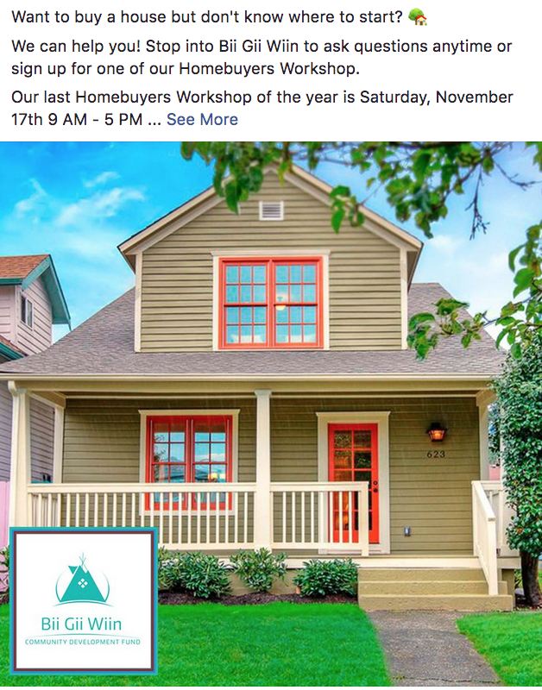
Facebook
High quality image consistent with brand style
Brief, concise description
Consistent BGW branding
Use emojis
Post 1x day
Add Facebook Analytics
Track user interaction
Best time, best day, favored content
Can see likes, # of potential friends of fans, weekly reach, actively talking about page, user engagement with post
Social Media Recommendations
Notes:
ZOE
Facebook Analytics
Track user interaction
Best time, best day, favored content
Can see likes, # of potential friends of fans, weekly reach, actively talking about page, user engagement with post

Slide 18
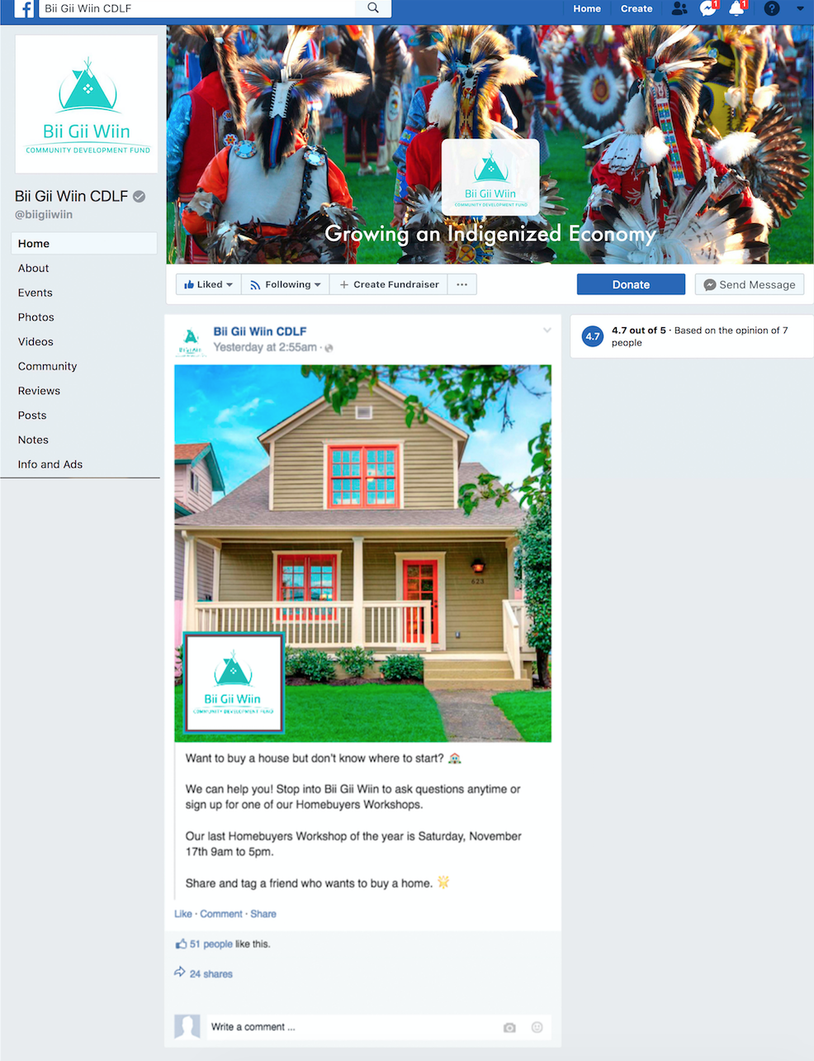
Example Facebook Post

Slide 19


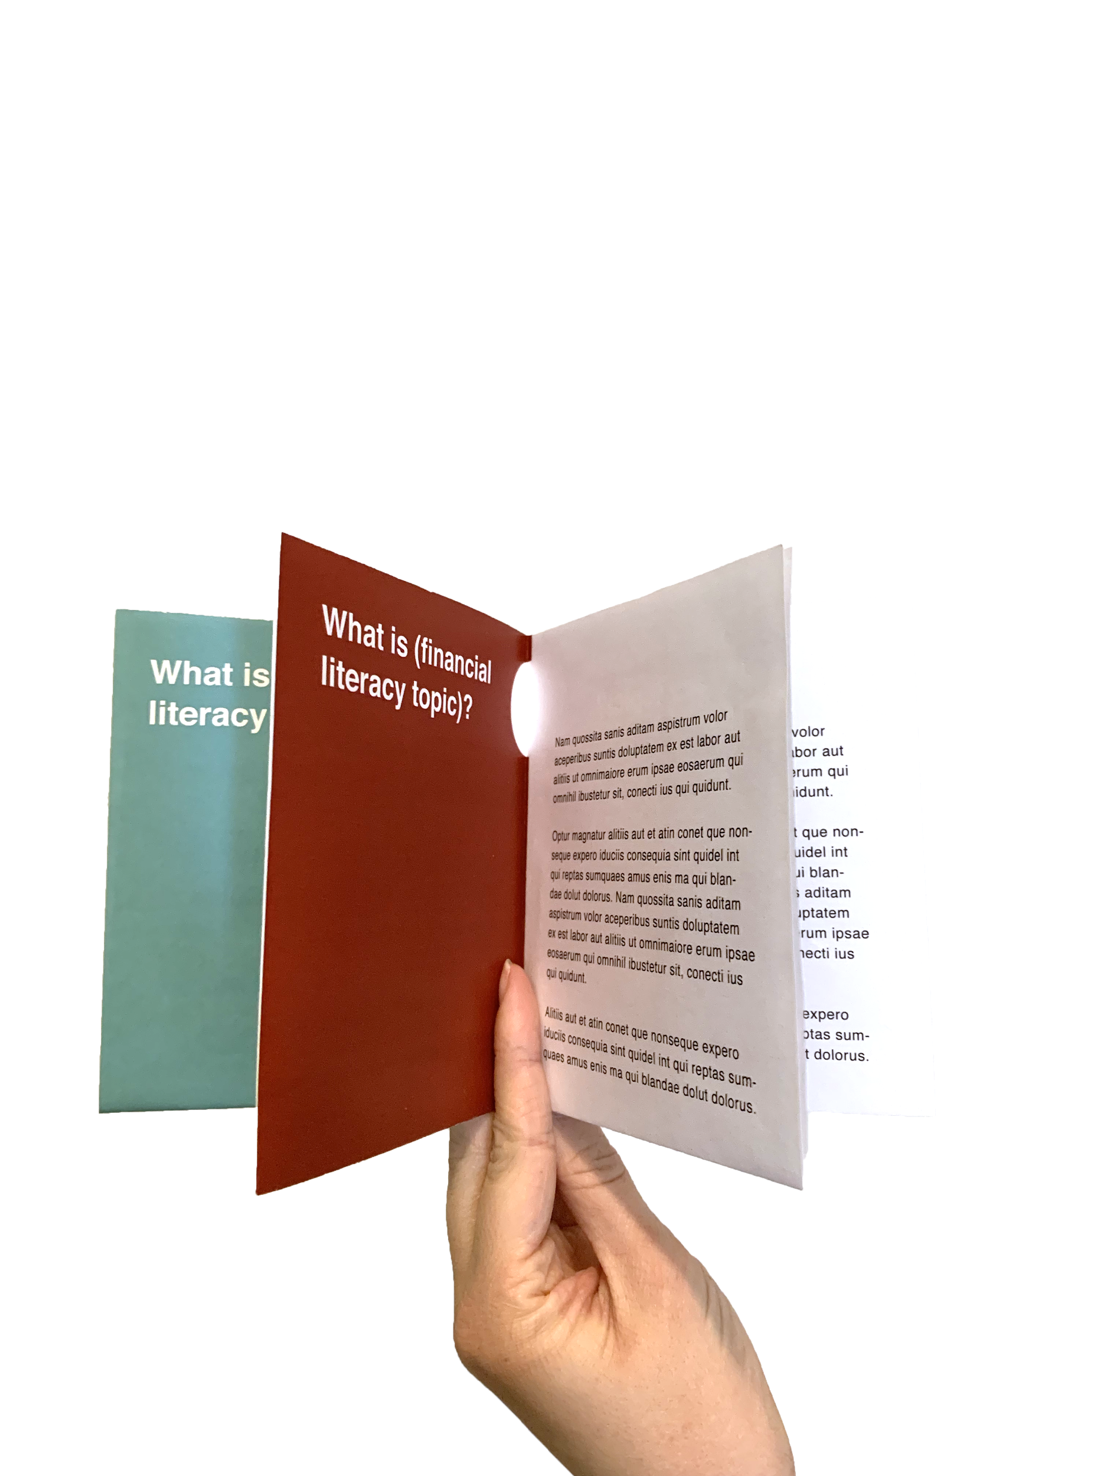
Information Guides
Notes:
BECCA
Gives them a tangible resource to use. Offers something people can reference back to after the workshops and offers next steps.
Not only is this an internal resource, but as these start to circulate through the community it offers a new touchpoint back to BGW whether they are mildly aware of the organization or loyal followers.
Deliverable 1: outline process and strategy to get to the outcome

Slide 20
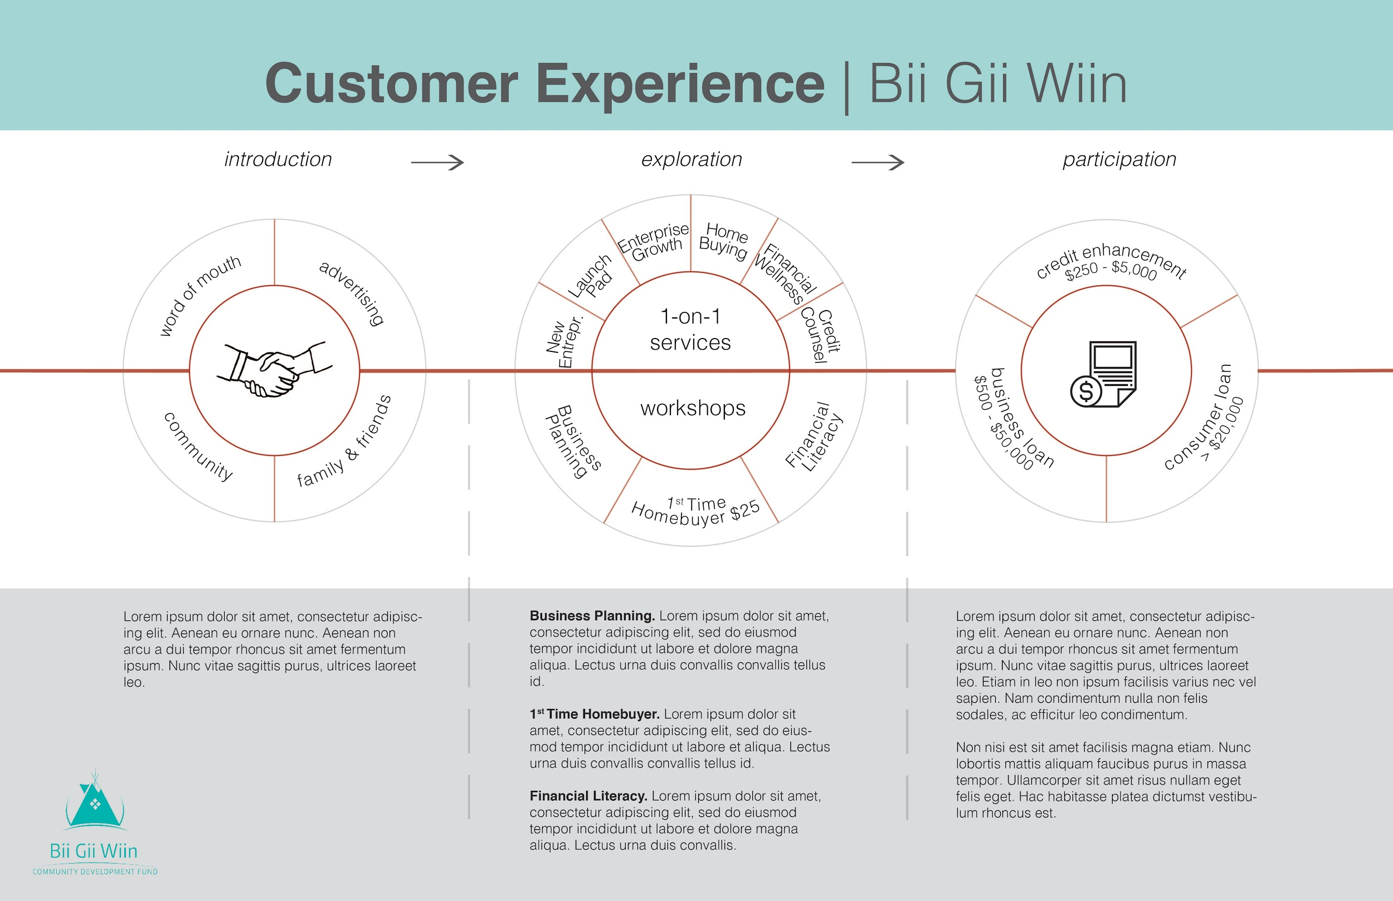
Customer Experience Map
Graphic laying out services
In-depth information
Notes:
ADRIA
You came in wanting something that outlined the customer journey - as the project evolved it turned into
I came at this as a third party - it allowed me to really explore what is available
External & internal resource - supplemental tool for them to use
This could be something that could available for people online to reference / download
It’s something that would have been useful for us at the beginning of this project

Slide 21
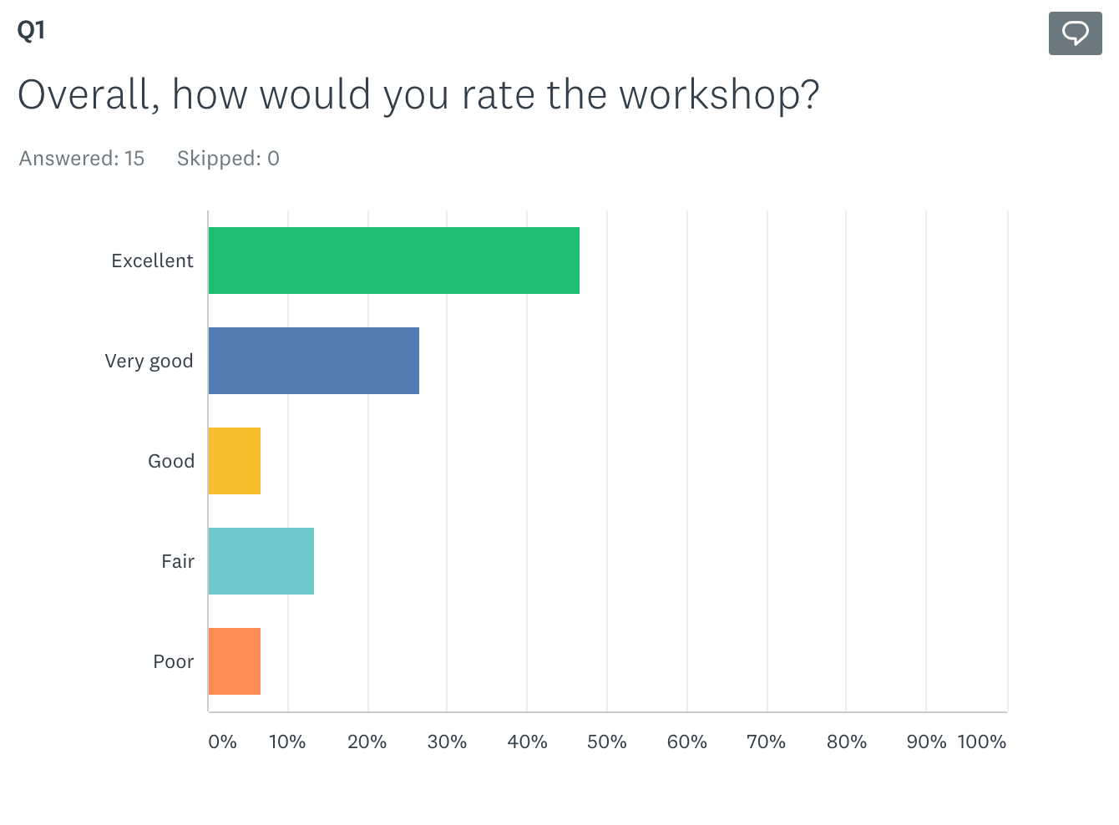
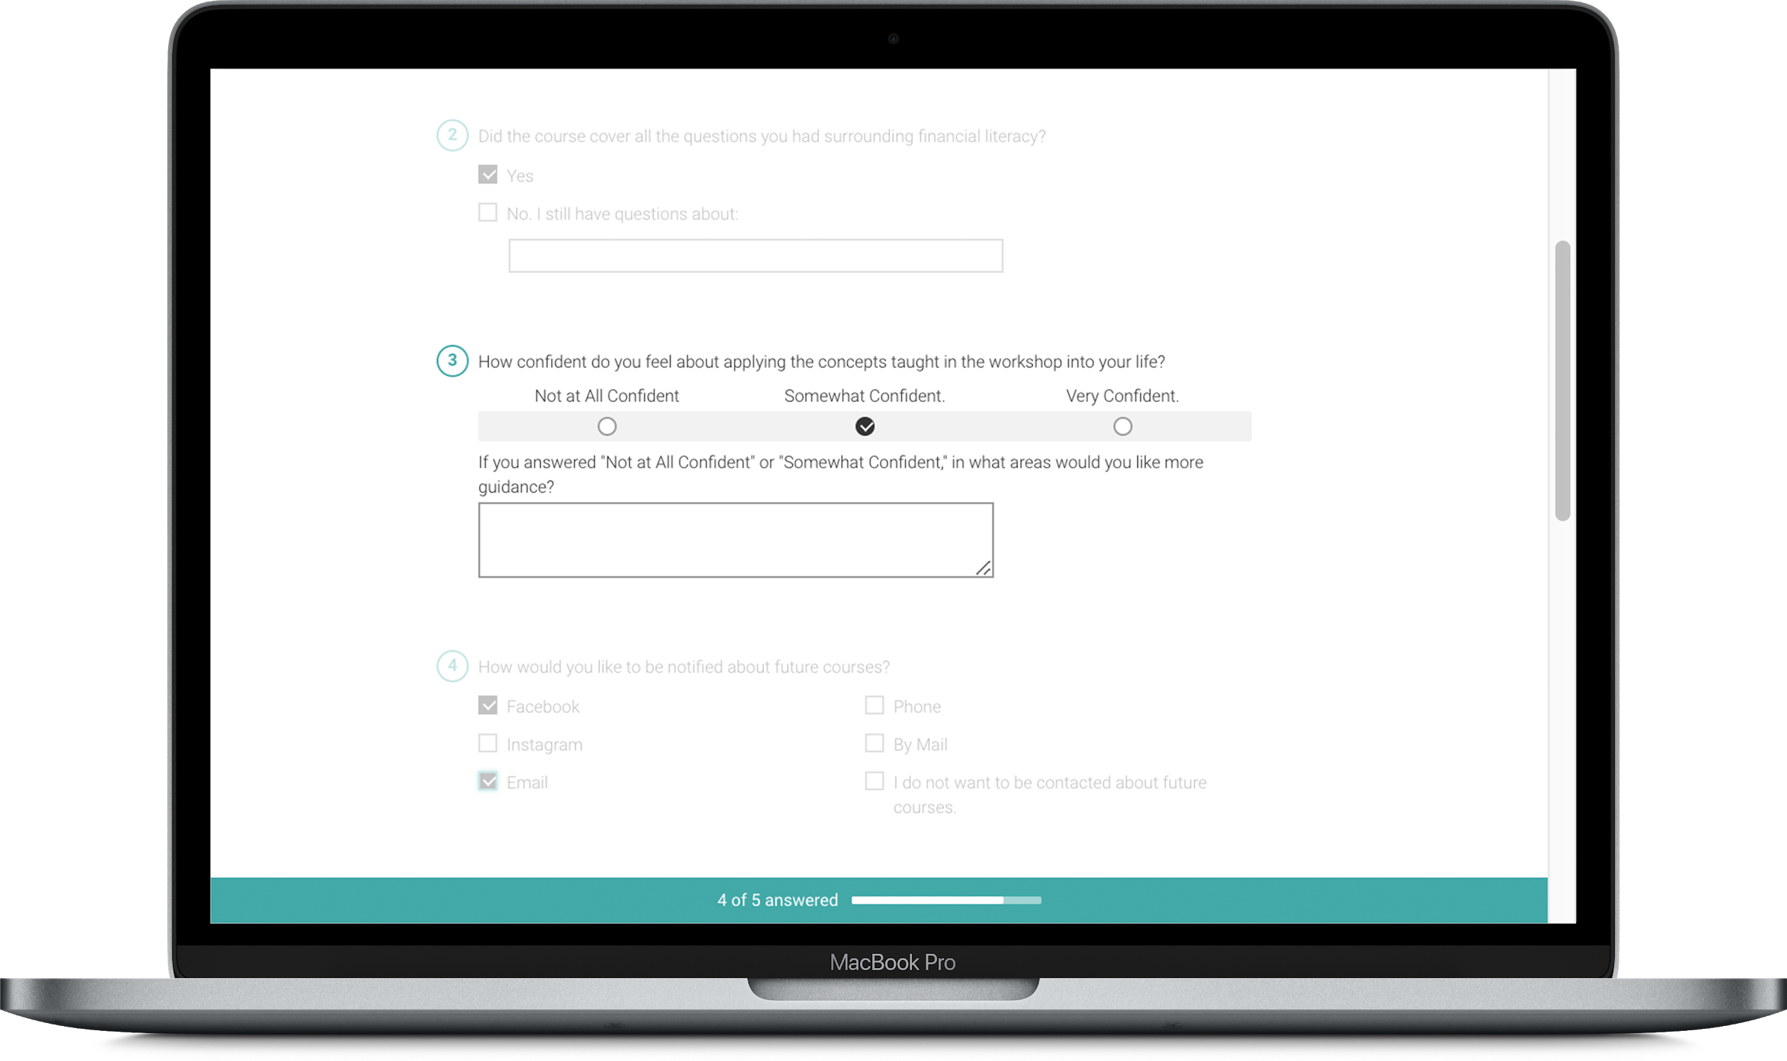
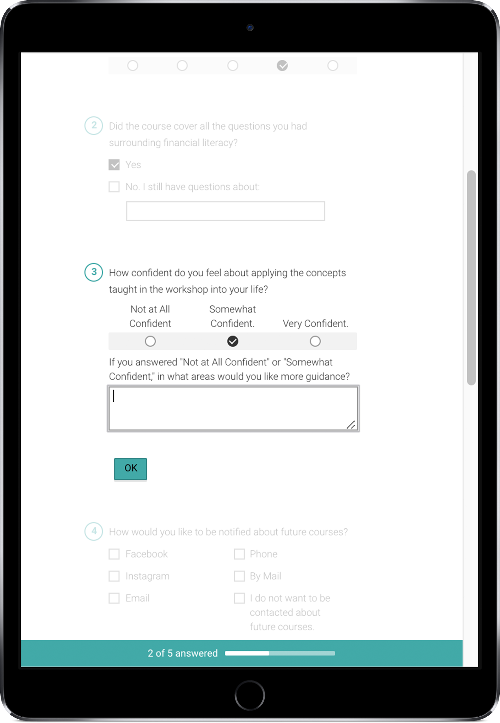
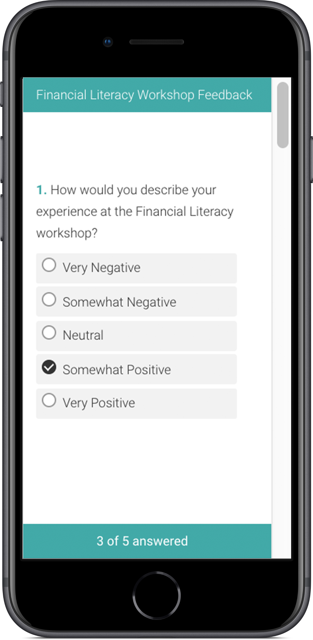
Feedback and Data Collection
Notes:
AUDREY
Deliverable 4: outline process and strategy to get to the outcome

Slide 22
Why these Deliverables?
Social Media Recommendations
Information Guides
Customer Experience Map
Data
Collection
Strengthen presence in order to reach a wider audience.
(Measure social media engagement through Facebook Analytics)
Provide comprehensive guides after courses and for outside enrichment.
(Measure downloads online and handouts in class)
Provide a visual representation of offerings from the organization.
(Staff feedback and downloads)
Streamlined method for collecting data and analyzing results.
(Feedback and insights gathered from data collected)
Notes:
AUDREY
Not so much fixing a problem but rather open an opportunity for growth.
Through our research we found that this issue is not so much a flaw in their system, but needing to leverage the strengths of their organization and the community they’ve cultivated already.

Slide 23
Wrapping Up
Notes:
BECCA
Thank you. Meeting 1 on 1 to go over next steps and to go over some of the smaller details.

Slide 24
Questions?

Slide 25
Additional
Information
Additional details on the previously discussed material
Notes:
Addendum slides

Slide 26
Statement of Work
Introduction
In the partnership between Bii Gii Wiin and MCAD, Bii Gii Wiin is seeking an outside perspective on broadening their market reach through their current stage of transition. Through this partnership, MCAD will evaluate how to increase awareness of the organization within the local community through a primarily research-based approach with additional attention to a revised marketing strategy. We will evaluate how to best reach more clients through community and cultural research with a marketing evaluation.
Goals of the Project
In order to address the needs outlined presented by the client and outlined above, we will approach our research from multiple perspectives. Our primary areas of focus will be talking with Native American community members, reaching out to the current partners of Bii Gii Wiin, and conducting a broad study of cultural design trends.
Objectives
Our deliverables for this project will be directly linked to our findings from the research outlined above. We will produce a detailed analysis of the customer journey, customer and target audience insights, and a comprehensive marketing plan outlining current practices and future strategic recommendations.

Slide 27
Statement of Work
Timeline
Weekly team meetings with bi-weekly email check ins with clients.
2-3 on site meetings with Bii Gii Wiin between MCAD meetings.
Oct 1, client meeting at BGW, discuss and approve Statement of Work.
Oct 8, client meeting at MCAD, interview guide for research completed.
Nov 5, client meeting at MCAD, bulk of research concluded.
Dec 10, final presentation at MCAD.
Glossary
MCAD- Minneapolis College of Art and Design
BGW- Bii Gii Wiin
Terms of Compensation
An estimated 25 hours per team member over the course of the project is to be completed for a total of 100 hours. An ongoing timesheet will be used internally among the team to track hours on projects. The work produced through this project will be available for team members to add to their portfolio in addition to being used by the client.

Slide 28
SWOT Analysis
Strengths
Location central to Native American Cultural Corridor
Well-established in community
Partnerships with local organizations
Expertise in financial education
Weaknesses
Small staff could limit immediate growth potential
Organizational leadership transitions
Office has limited street visibility
Previous mismanagement of funds
Loan fund currently near capacity
Opportunities
Potential staff expansion
Underdeveloped social media presence
Establishing regular follow-ups with clients
Business-consulting services
Threats
Political tension (local and national)
Multiple organizations offering similar services
Loan sharks
Notes:
Define what you learned about the company through this process: a SWOT analysis. Talk about one in each area.

Slide 29
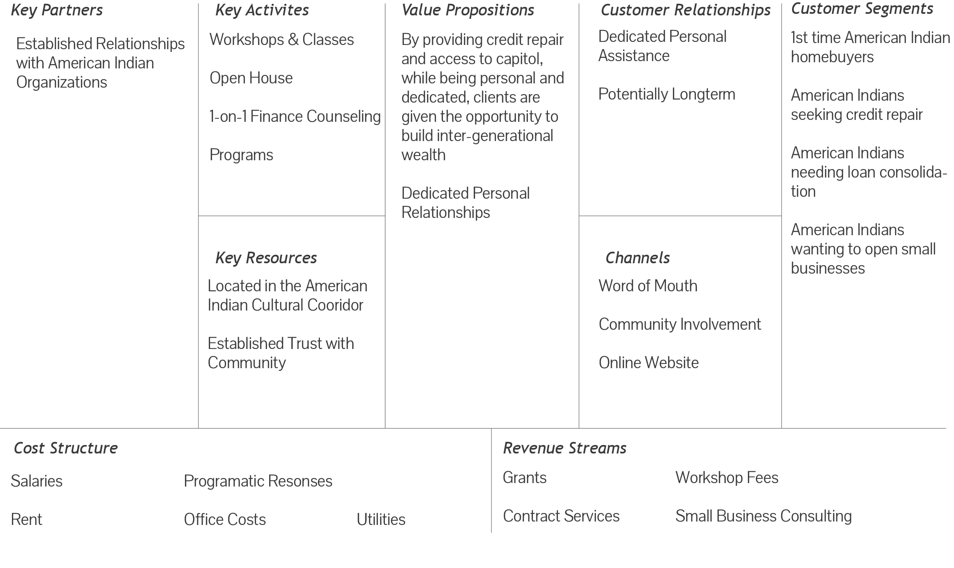
Business Model Canvas (BMC)
Notes:
A business model canvas of the company

Slide 30
External Research Findings
Purpose: To Understand Community and Context for Our First Person Research
Assimilated, not excluded
“Indian” is a colonist term – existed as tribal identity, not collective
Indigenous identity needs to be won both by colonizers and by community
Many more tribes than officially registered because was a disadvantage at the time to register, so data may be a little off
Identity is based on land but can be fluid
In conversations, both sides need to share and be vulnerable
Notes:
Wrap up discussion: include your recommended next steps; thank them for the opportunity

Slide 31
External Research Findings cont.
Minnesota Department of Employment and Economic Development (DEED)
Stats for American Indians
American Indian & Alaska Native
2016 Metro Area Minnesota
16,872 (.6% pop) 1% of population
American Indian Education Attainment
aged 25+ less than hs diploma 17.5%
hs graduate 33%
some college 33.7%
bachelor’s + 15.9%
Metro Area Median Household Income $43,183 ($33k less than white)
Job Education Requirements Metro Area: 60.8% of jobs need hs diploma or less
Notes:
Wrap up discussion: include your recommended next steps; thank them for the opportunity

Slide 32
Internal Research Findings
Purpose: To understand where BGW is currently in relation to the rest of the industry
The current design is on trend with others in the industry
Website copy and workshop descriptions could benefit from further clarification
Clean design but missing photographs and personal touch
A majority of initial traffic seems to be from the workshops, but they aren’t terribly present on the homepage
Start today is a nice touch, making it as simple as possible
Get info on response rate to base feedback form on
Notes:
Wrap up discussion: include your recommended next steps; thank them for the opportunity

Slide 33
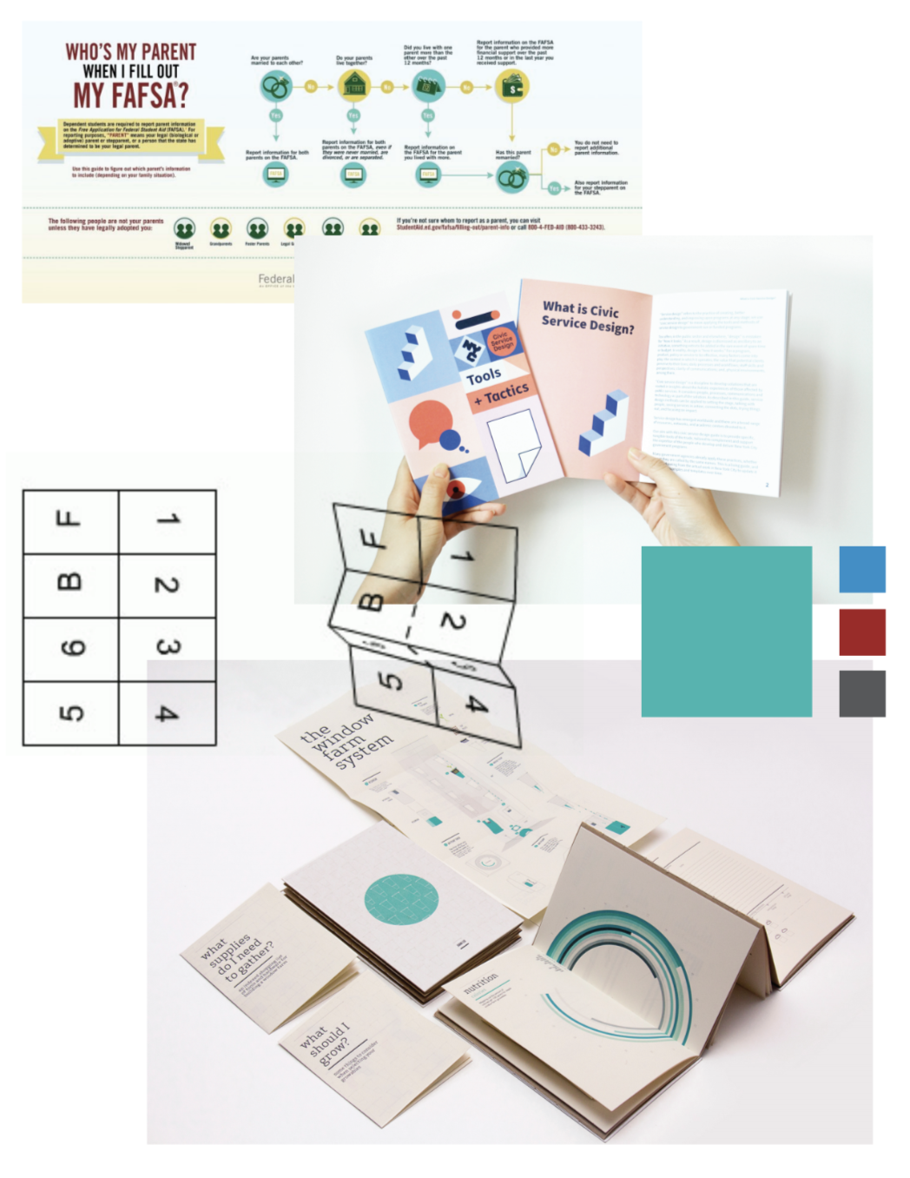
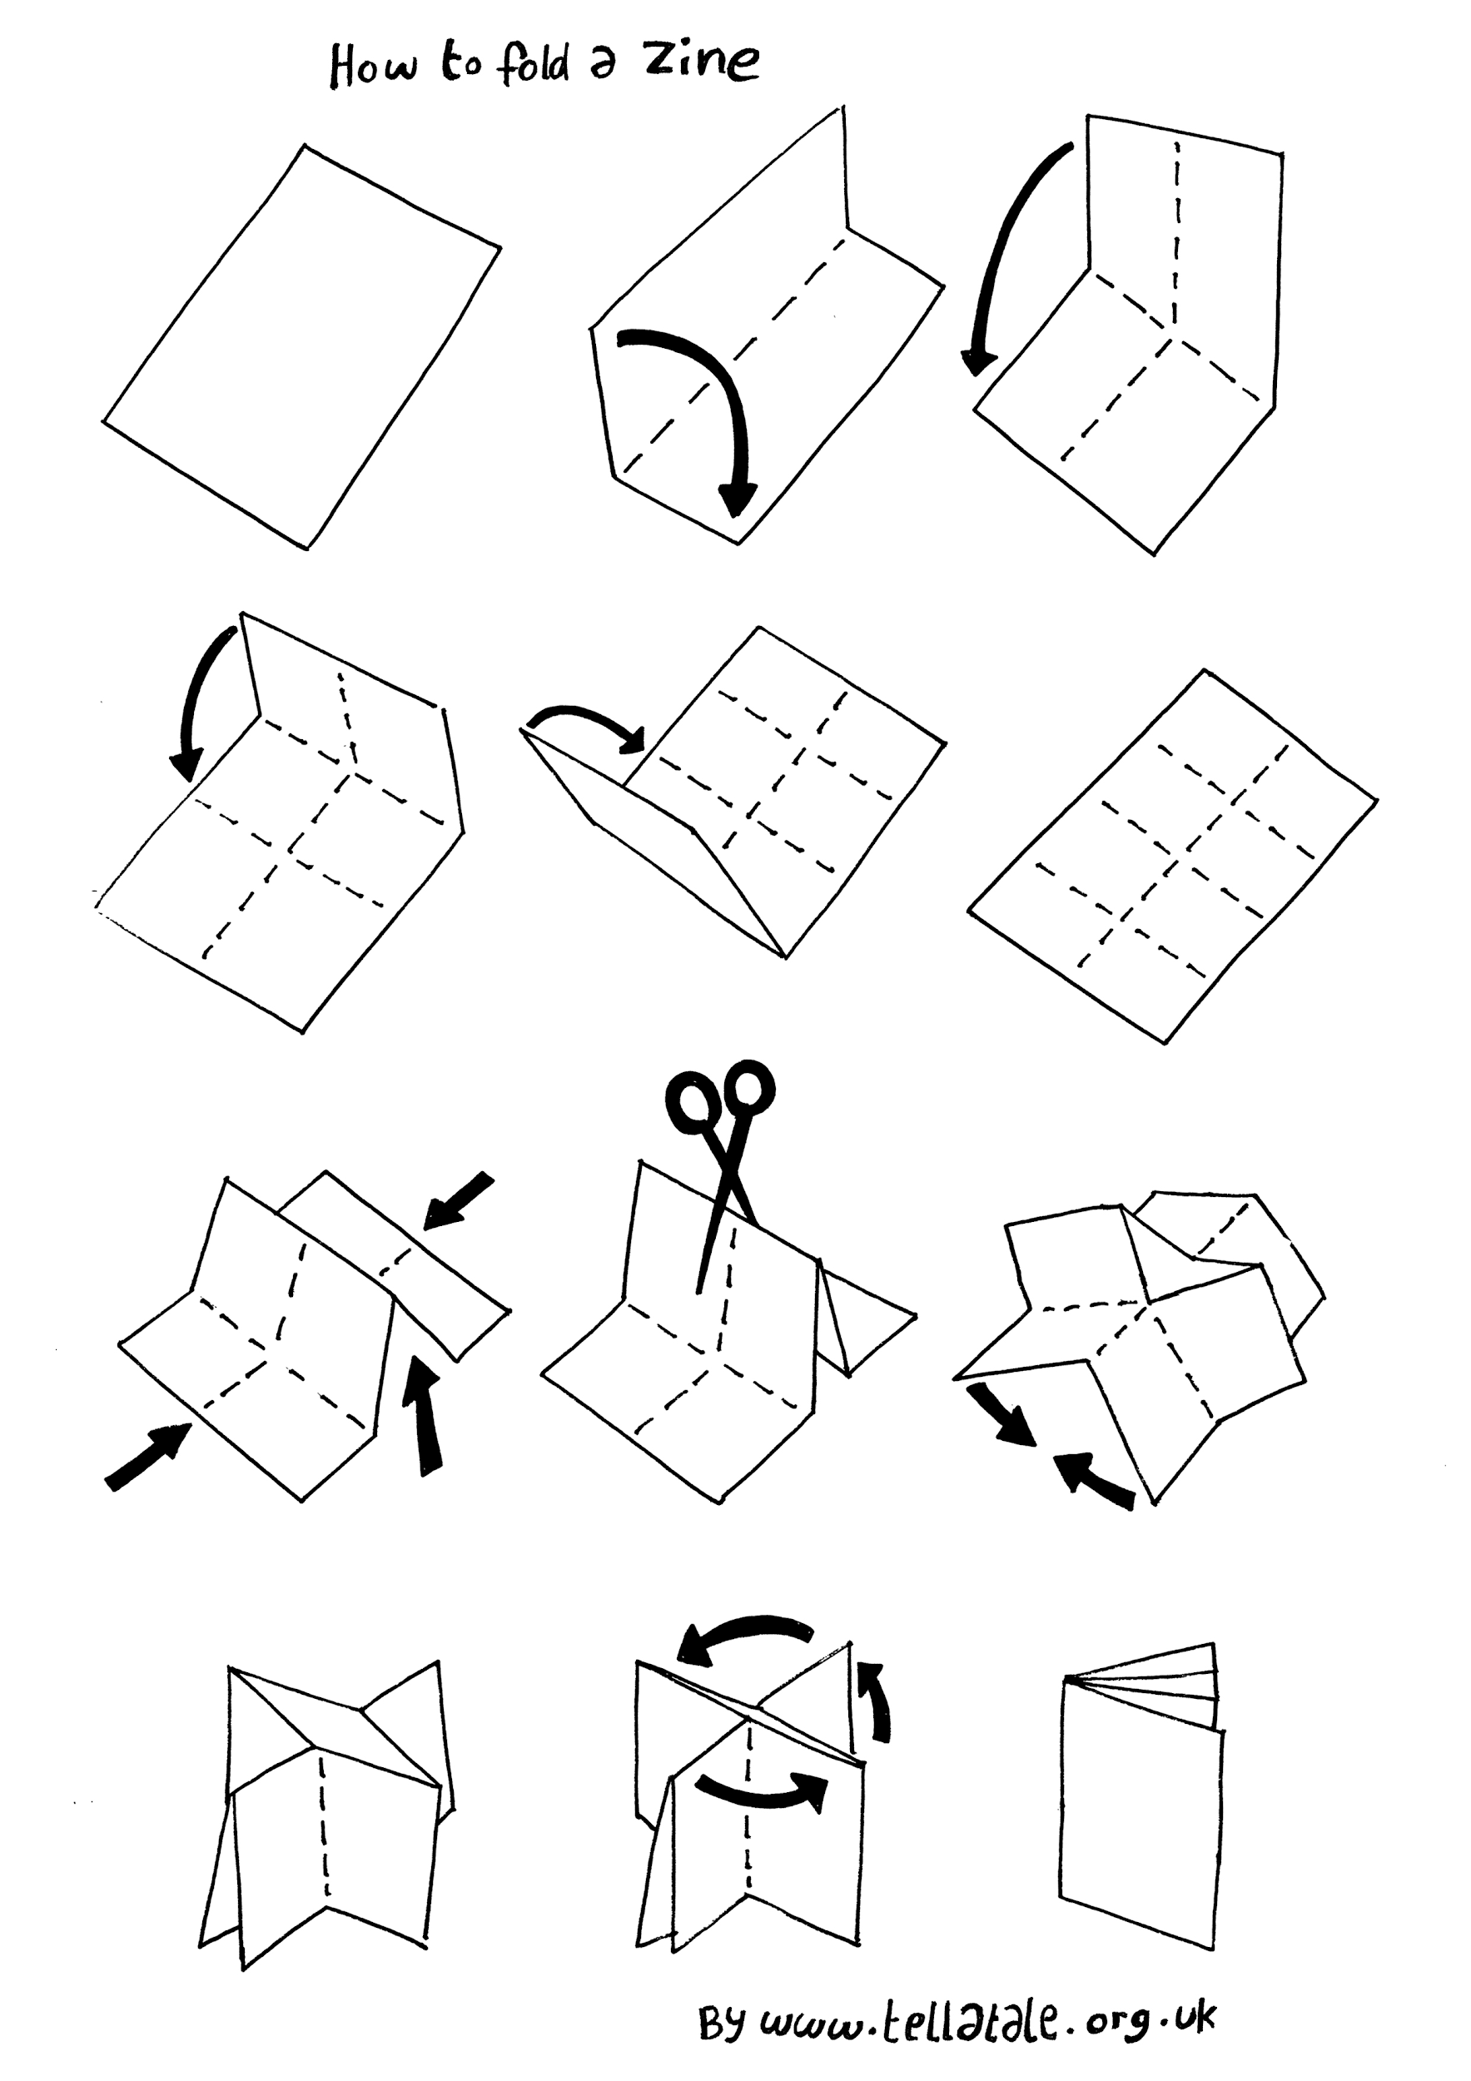
Mood Board for Guides
Notes:
Wrap up discussion: include your recommended next steps; thank them for the opportunity

Slide 34
First Person Research Findings
Purpose:
To gain a better understanding of those currently and previously involved with BGW. Their introduction to the organization, their experience, and where they are in relation to the organization currently.
Methods:
Two different focus groups for a total of 3 interviewees.
6 phone interviews.
Primary Themes:
Most people agree that they love Andrea and see her presence heavily in the community—bodes well for BGW.
A majority of people agree that they wish they had been introduced to BGW earlier, and have explicitly said they would see the benefit of introducing it to other people earlier.
Most did not have a clear understanding of which services BGW offers and when they are.
Notes:
Wrap up discussion: include your recommended next steps; thank them for the opportunity

Slide 35
Social Media Best Practices
Instagram Steps
Find a good photo
Include call-to-action - like asking viewers to respond to the post
Use 5 to 30 hashtags - 11 is recommended
Use emojis - catches peoples’ attention
Instagram Recommendations
Make sure photo is pretty
Consistency is good - keeps the brand recognizable
Research hashtags used by similar companies to get inspiration
Post once a day
Facebook Recommendations
Currently posting all events happening - great!
Try to use more consistent photos if you can - it keeps the brand more recognizable
Notes:
Deliverable 3: outline process and strategy to get to the outcome

Slide 36
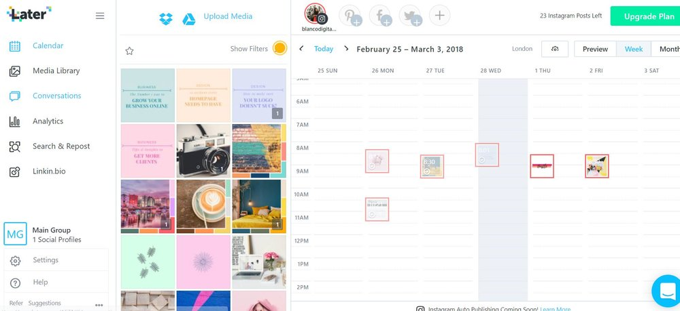
Social Media Tool
Automation: Use Later.com
works for Pinterest, Instagram, Facebook, and Twitter
Can upload photos & messages up to 2 weeks in advance
Recommend setting a date & putting it into calendar (ex. every Monday)
Recommended to post daily
Notes:
Deliverable 3: outline process and strategy to get to the outcome

Slide 37
The Guides
What We Heard
People were looking for additional information after the workshops
They were looking to a reference guide of some kind when they didn’t have time to commit to an entire workshop
Useful, quick bits of information that they could follow up on if needed
The Design
Easily customizable
InDesign format
BGW branding
Clean design that can be used with a variety of topics
The Mission
To create something that people interested in or involved with BGW can use to gain additional information about their programs and financial literacy topics. Could be used as a form of marketing to raise awareness in the community by distributing these guides at community centers.
Notes:
Deliverable 1: outline process and strategy to get to the outcome

Slide 38
Customer Experience Map
What We Heard
Internally, you wanted something that shows the path customers take through the organization
People were unaware of all the services BGW provides
The Design
Easily customizable
InDesign format
BGW branding
Clean design
The Mission
To create a map that can visually layout everything BGW has to offer. Can be used for internal purposes or as a handout for customers.
Notes:
Deliverable 1: outline process and strategy to get to the outcome

Slide 39
Feedback and Data Collection
What We Heard
Bii Gii Wiin has collected information but don’t have the data in a useful format
Customers were eager for more follow-up after workshops
Customers were eager to offer advice and feedback when asked
The Platform
SurveyMonkey is free and very intuitive
Data Visualization tools simplify the analysis process
Surveys can be easily shared by email, direct link, or in “kiosk” mode
The Mission
As an organization committed to the community, it’s vital to constantly asses if the community needs are being met. By implementing a survey system, Bii Gii Wiin can easily collect feedback, open communication with their customers, and use the data to make improvements as needed.
Notes:
Deliverable 1: outline process and strategy to get to the outcome

Slide 40
Additional Considerations
Based on Our Research, for Future Semesters We Would Recommend a Focus On:
Brand messaging on website and social media
Look into potential for earned income from business consulting
Grow business to business consulting opportunities
Consider additional program offerings targeted toward a younger demographic and some of the suggestions from our research
Explore new routes of funding
Increase communications regarding upcoming opportunities with past and current customers
Notes:
Deliverable 1: outline process and strategy to get to the outcome

Slide 41
Pull Quotes
“It was really easy to learn from Andrea”
“I go back and reference the cheat booklet often”
“I’d highly recommend the workshop to anyone who needs to learn. Especially in high school”
“Financial literacy is a brand new world. My eyes are open”
“How does this fit into my life now?”
“Heck yeah, I want to be my own boss! But I need a coach to guide me through the process”
“I’m sad that it’s not the first thing on the priority list for young people”
“Paperwork is a huge barrier. Even just sitting down in front of a computer.”
“The native community is vibrant and beautiful but also shady. I don’t want to become a statistic”
“Don’t always feel like I have enough time to commit to a course”
“As a young person, you don’t think about long-term planning. The focus is on “what can you do for me now”’
“Not as involved (with BGW) as I’d like to be. Busy with life and personal life”
“I don’t think responsibly enough to prioritize financial education in my free time”
“Now that I’m older, I see the value of the dollar and less need for instant gratification”

Slide 42
Next Steps
For social media, post more frequently to Facebook (particularly events, workshops, and other services that BGW offers) and make images more cohesive.
For the information guides, summarize the information needed for these financial literacy topics. Update the InDesign files and handout within the community and people affiliated with BGW.
For the customer experience map, determine what in-depth information is necessary to include in order for customers to gain a better understanding of BGW’s offerings. Update the InDesign file for internal use; potentially handout to the community.
For the data collection, customize a survey on SurveyMonkey and share it with relevant parties. In order to get consistent, comparable feedback, plan on sending it soon after the workshop to establish regular contact.
Notes:
Wrap up discussion: include your recommended next steps; thank them for the opportunity

Slide 43
Notes:
Addendum slides

